Slide 1
From Embeddings to LLMs
John R Ballesteros
Full Professor
jballes@unal.edu.co

Slide 2
Word2Vec
Efficient Estimation of Word Representations in Vector Space. Mikolov et al, 2013
Addresses the limitation of traditional NLP, “no notion of similarity between words.”
A powerful property discovered with these vectors is their ability to capture "linear regularities" or "semantic and syntactic relationships between words“
Crucial for NLP tasks: machine translation, information retrieval, question answering, and natural language inference.
The "quality" of these representations is measured by their ability to answer semantic and syntactic analogy questions.

Slide 3
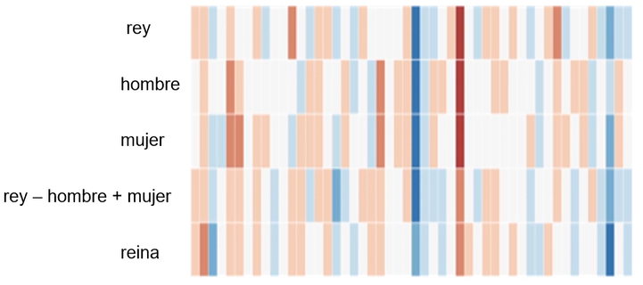
Vector Arithmetic
Modified from Mikolov, 2013

Slide 4
Embeddings
An embedding is a numerical (vector) representation of a piece of information, for example: sequence of text,
documents, images, audio, etc. The representation captures the semantic meaning of what is being embedded, making it robust for many industry applications.
Embedding is like a semantic Encoding

Slide 5
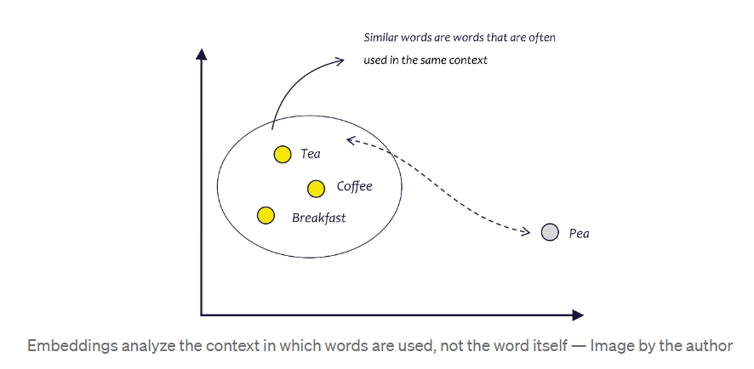

Slide 6
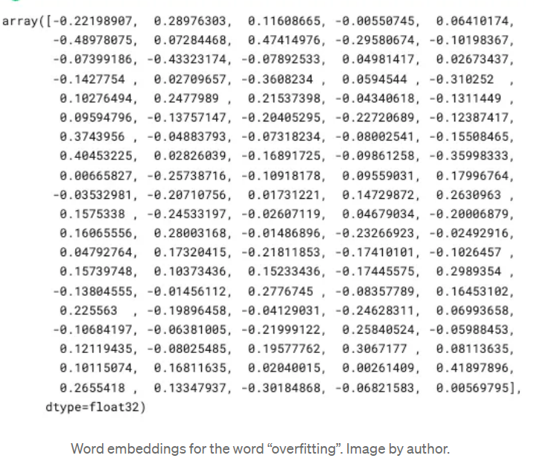

Slide 7
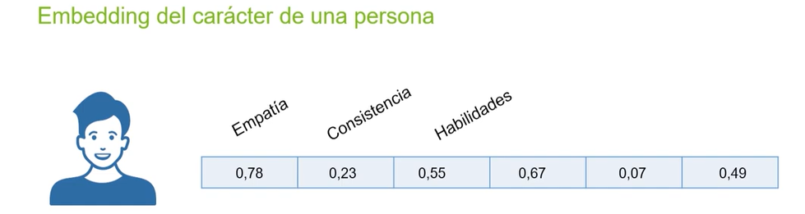

Embedding example
Similar or not?

Slide 8
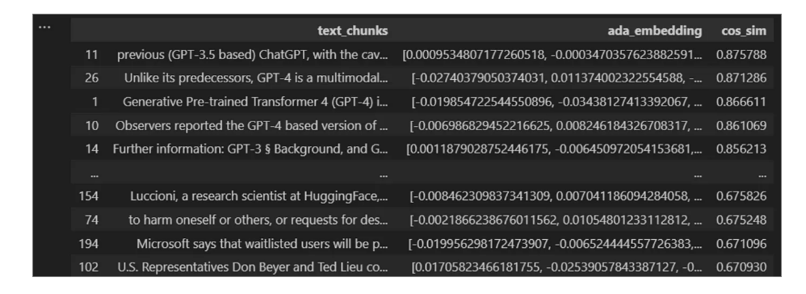
Similarity based on the cosine distance [-1,1]

Slide 9
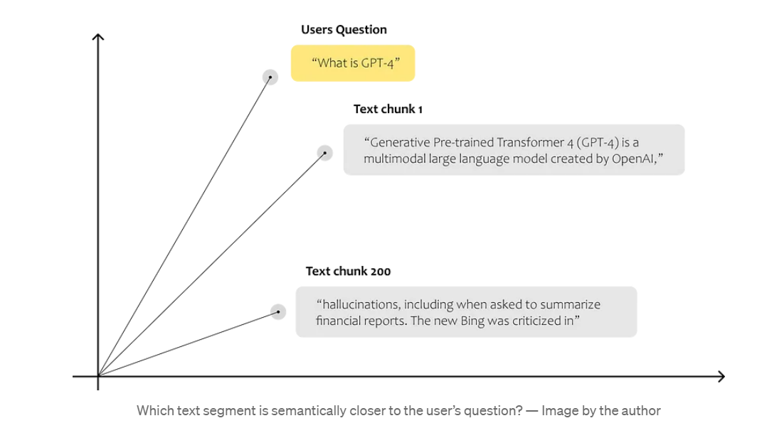
Similarity based on the cosine distance [-1,1]

Slide 10











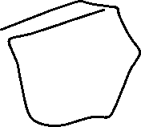






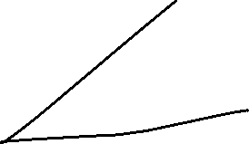





Slide 11
Vector Databases
They are specialized systems designed for storing, managing, and searching embedding vectors.
Chromadb (Open Source)
Qdrant (light and poweful)
Pgvector (It’s an extension of PosgreDB)
Pinecone (Industry default, but expensive)
Weaviate (Private)

Slide 12
Vector Databases Comparison Parameters
Number of records
Number of dimensions they can store (512, 1024, 2000, etc)
Number and type of algorithms to search: similarity, distance
Opensource or private
Price
Speed of search
Similarity search algorithms

Slide 13
LLM
An advanced deep neural networks that excel at processing, understanding, and generating human-like text.
The Transformer architecture is trained on vast quantities of text to learn the intricate patterns of language, enabling them to perform NLP tasks.
They can perform tasks they weren't explicitly trained for and can be "fine-tuned" for specific tasks and guided by "prompt engineering"

Slide 14
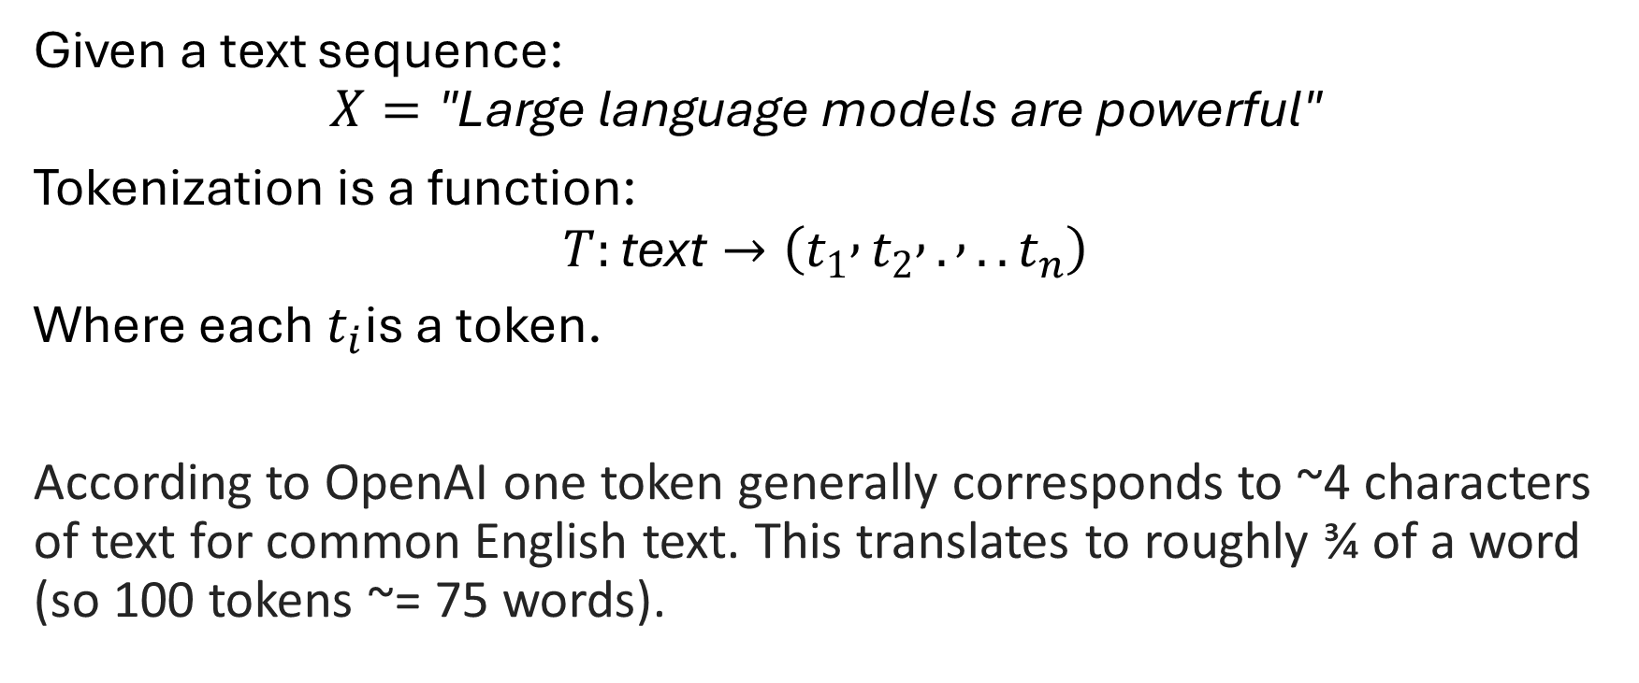
A token
Given a text sequence:
$$X=\text{"}\text{Large} \text{language} \text{models} \text{are} \text{powerful}\text{"}$$
Tokenization is a function:
$$T:\text{text}→\left(t_{1} , t_{2} , . , ..t_{n}\right)$$
Where each $t_{i}$is a token.
According to OpenAI one token generally corresponds to ~4 characters of text for common English text. This translates to roughly ¾ of a word (so 100 tokens ~= 75 words).

Slide 15
Tokens ≠ Words
Depending on the tokenizer, tokens can be:
Words
Subwords
Characters
Byte-level units
For Example: "unbelievable“:
- Word-level:["unbelievable“]
Subword tokenization (BPE-like):["un", "believ", "able"]
Character-level: ["u","n","b","e","l","i","e","v","a","b","l","e"]

Slide 16
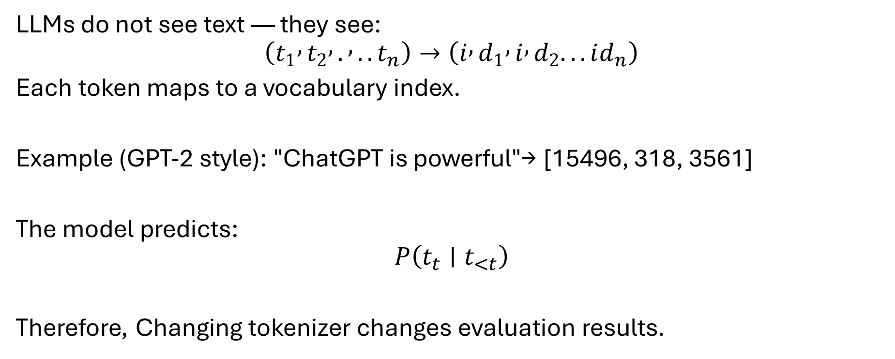
Why Tokenization Matters in LLMs
LLMs do not see text — they see:
$$\left(t_{1} , t_{2} , . , ..t_{n}\right)→\left(i , d_{1} , i , d_{2}...id_{n}\right)$$
Each token maps to a vocabulary index.
Example (GPT-2 style): "ChatGPT is powerful"→ [15496, 318, 3561]
The model predicts:
$$P\left(t_{t}∣t_{<t}\right)$$
Therefore, Changing tokenizer changes evaluation results.

Slide 17
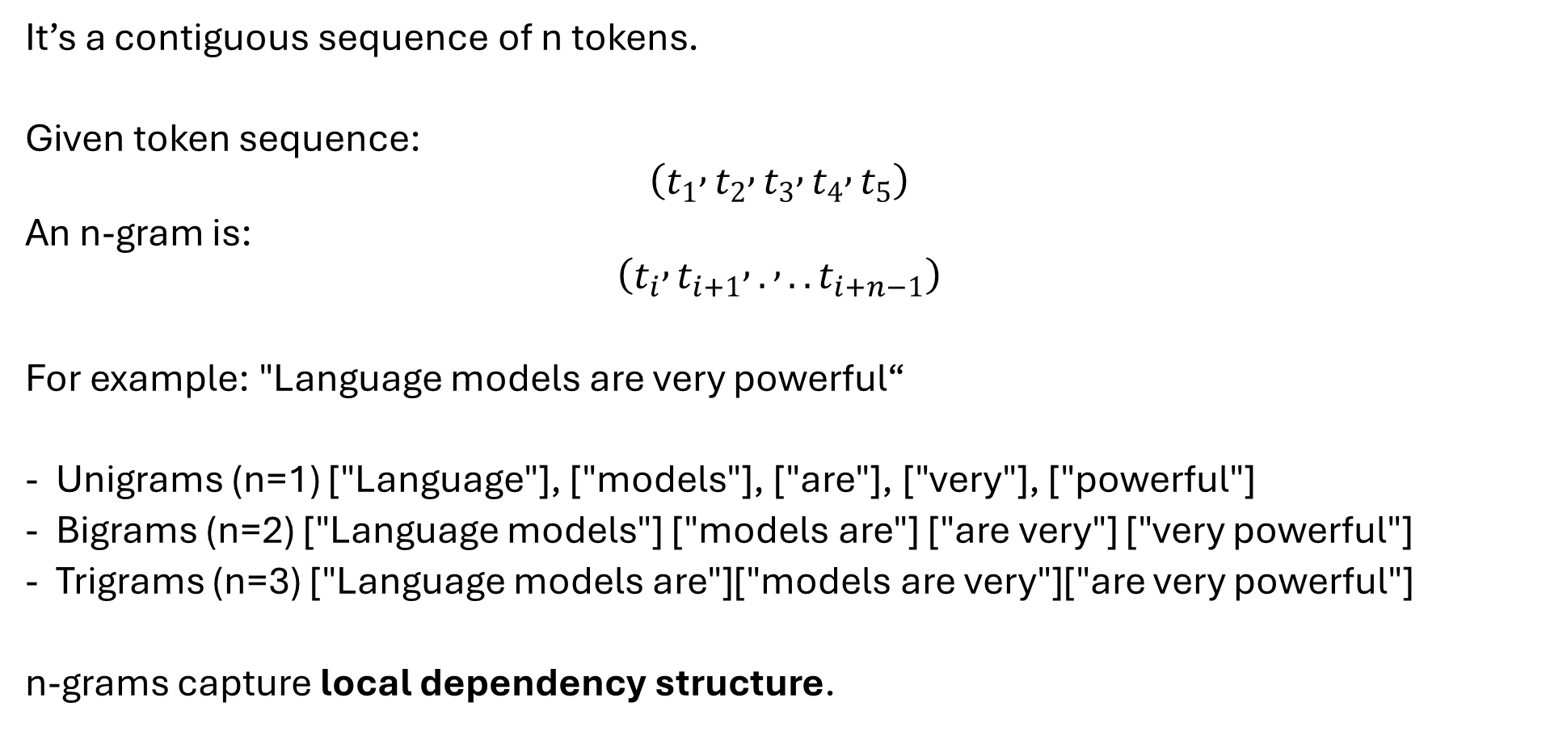
What Is an n-Gram?
Unigrams → vocabulary distribution
Bigrams → short dependency
Trigrams → short phrase structure
Higher n → stronger structural constraints
It’s a contiguous sequence of n tokens.
Given token sequence:
$$\left(t_{1} , t_{2} , t_{3} , t_{4} , t_{5}\right)$$
An n-gram is:
$$\left(t_{i} , t_{i+1} , . , ..t_{i+n−1}\right)$$
For example: "Language models are very powerful“
Unigrams (n=1) ["Language"], ["models"], ["are"], ["very"], ["powerful"]
Bigrams (n=2) ["Language models"] ["models are"] ["are very"] ["very powerful"]
Trigrams (n=3) ["Language models are"]["models are very"]["are very powerful"]
n-grams capture local dependency structure.

Slide 18
Example
Reference: "The cat is on the mat"
Candidate: "The cat sat on the mat“
Unigram overlap (Common tokens):
The, cat, on, the, mat
Bigram overlap (Matches): The cat, on the, the mat
Lower than unigram precision.
Trigram overlap (Matches): on the mat
Precision drops further.

Slide 19
Subword Tokenization in Modern LLMs
Modern LLMs use BPE (Byte Pair Encoding), also known as Symbol Pair Encoding splits words into frequent units, To solve:
Rare words, Open vocabulary problem, Morphology
Example: "internationalization“, Instead of OOV:
["international", "ization"]
This reduces vocabulary size, sequence length and improves generalization. Does not use linguistic rules.

Slide 20
Why BPE Works
Frequent morphemes become tokens
Rare words are decomposed
Open vocabulary achieved
Example: "unbelievable“ might tokenize as:
["un", "believ", "able"]
If later we see "believable“, it reuses: ["believ", "able"]
Generalization improves.
GPT-2: 50,257 tokens
LLaMA: ~32,000 tokens
Text → Tokens → Token IDs → Embeddings → Model

Slide 21
Transformer architecture and its evolution
"Attention Is All You Need" (2017), is comprised of an "encoder" - "decoder.“
Encoder: transforms the input sequence into a continuous representation containing contextual information for each token. It uses multi-head self-attention, feed-forward networks, normalization layers, and residual connections. Positional encodings are added to embeddings to preserve word order.

Slide 22
Decoder: generates the output sequence based on the contextual information from the encoder. It operates token-by-token using "masked self-attention" (prevent seeing future tokens) and "encoder-decoder cross-attention" (to focus on relevant parts of the input).
From GPT-3, Llama on LLMs have adopted a "decoder-only" variant of the Transformer architecture. This simplifies the model by merging the encoding and decoding functions, focusing solely on generating output sequences directly from the input using masked self-attention.

Slide 23
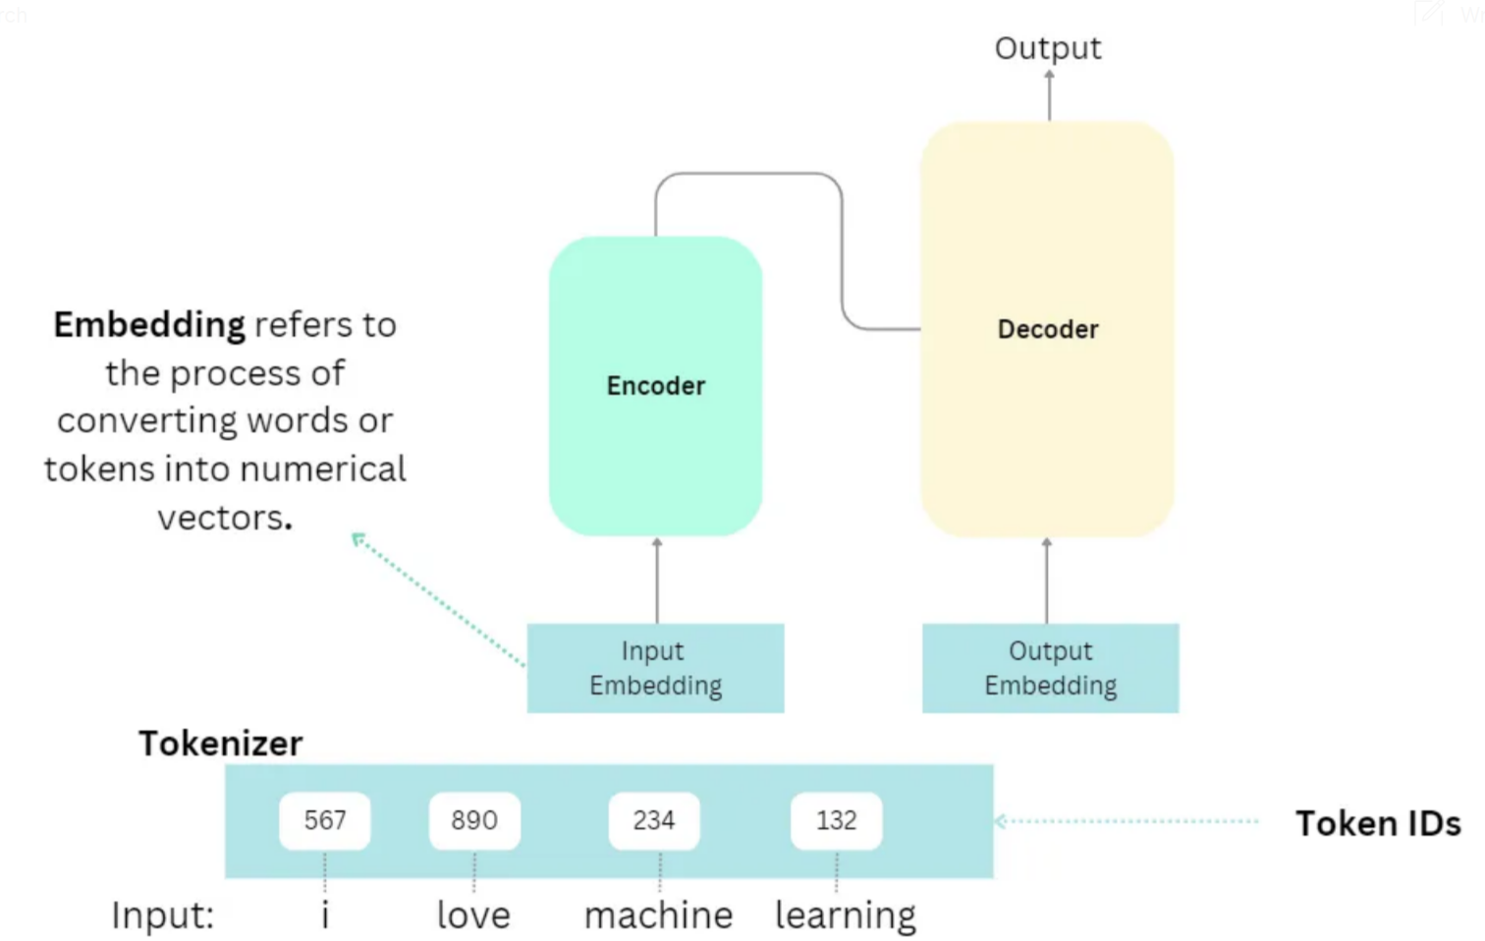

Slide 24
How do Transformer models process language?
Revolutionized sequence processing by a mechanism called "self-attention." Older models (RNNs) process tokens sequentially,
It can process entire sequences in parallel, allowing them to model “long-term contexts" more effectively and speed up training.
“Multi-head attention" module (the "self-attention" mechanism) generates three specialized vectors: a "query" (Q), a "key" (K), and a "value" (V) for each input word (token).

Slide 25
Query help the model ask which other words are relevant.
Key act as labels to identify how a word might be relevant to others.
Value hold the actual content information of the word.
"Scores" are calculated by the dot product of a word's query vector with the key vectors of all other words in the sequence.
Scores are then normalized using a softmax to produce "attention weights," which indicate the strength of connection between words.

Slide 26
Finally, each value vector is multiplied by its corresponding attention weight, and the results are summed up to create a "context-aware representation" for each word.
This mechanism allows the model to dynamically focus on relevant parts of the input, like understanding that "it" in a sentence refers to the subject i.e. "the cat"

Slide 27
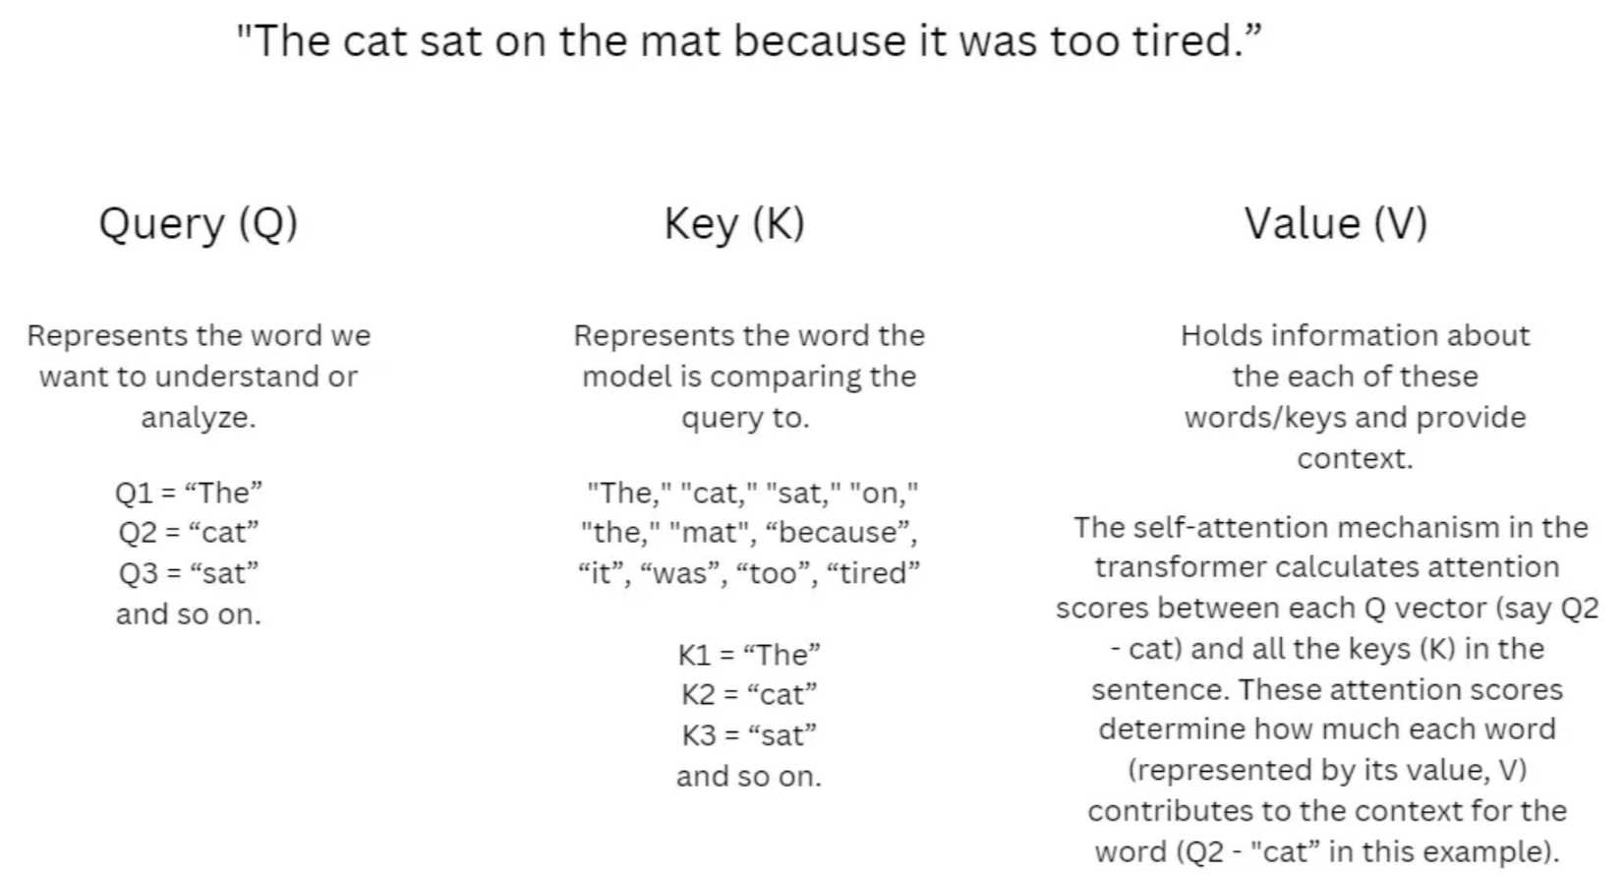

Slide 28
Sub word and Multi words tokens
sub-word tokenization breaks down a word into smaller parts like its root, prefix, suffix, and other linguistic elements.
For example, the word “tiresome” can be split into “tire” and “some,” while “tired” can be divided into “tire” and “d.” By doing this, we can recognize that “tiresome” and “tired” share the same root and have a similar derivation. (Wang, 2023)

Slide 29
Tokenization (Byte Pair Encoding (BPE))
Subword tokenization
Begins with a vocabulary of single characters as the base units.
Iteratively merges the most frequent pairs of tokens to form new tokens.
This merging continues until the tokenizer reaches a predefined vocabulary size.
Known for being simple and effective, and widely adopted in models like GPT and RoBERTa.

Slide 30
Unigram Language Model
the unigrams: [“Read”, “this”, “sentence”, “for”, “me”]. Here are all the bigrams: [“Read this”, “this sentence”, “sentence for”, “for me”, ”Read”, “this”, “sentence”, “for”, “me”].
Starts from the entire corpus vocabulary, including all words and possible subwords.
Then progressively removes or splits tokens that contribute least to performance.
Continues pruning until the target vocabulary size is reached.
Often performs better with diverse text types

Slide 31
WordPiece
A predecessor to Unigram, used in BERT.
Focuses on maximizing the likelihood of the training data using a fixed vocabulary.
The official implementation by Google was never open-sourced, but alternatives exist.

Slide 32
Comparative Insights
No single algorithm is universally superior; performance depends on the dataset and task.
BPE and Unigram generally offer strong and consistent results across many scenarios.
evaluation criteria include:
Token efficiency (fewer tokens per sentence)
Handling of domain-specific words
Vocabulary adaptability, language and size

Slide 33
Types of Pre-training of LLMs
Supervised (sequence to sequence)
Corpus of questions and answers
Corpus of papers and abstracts
Unsupervised (context or hidding)
Mask Modelling Language (MML): “The [MASK] sat on the mat”
Next Sentence Prediction (NSP): “The cat sat on the _______”

Slide 34
BERT: Bidirectional Encoder Representations from Transformers
Deep context understanding using both MML and NSP
Entity Name Recognition, Question and Answer, and Sentiment Analysis
Since it’s encoder only, cannot generate text
Devlin, 2018

Slide 35
Fine-tuning of LLMs
A post-pre-training stage in the development of Large Language Models (LLMs). After the "pre-training" on massive, diverse datasets to learn general language understanding and generation, fine-tuning specializes the model for specific tasks or domains.

Slide 36

Fine tuneable LLMs
LLM | Type | Size (MP) | Pre-trained | Use | Paper
T5 Text-To-Text Transfer Transformer | Encoder-decoder | 60 | C4 dataset | translation, summarization, question answering | Colin Raffel et al. (Google), 2019
FLAN T5 Fine-tuned Language Model T5 | Encoder-decoder | 60 | Multiple datasets | translation, summarization, question answering plus reasoning tasks | Google Research, 2022
Bert Bidirectional Encoder Representations from Transformers | Encoder Only | 110 | BooksCorpus, English Wikipedia. | Text classification, Q&A | ZJacob Devlin et al. (Google), 2018
XLNet Extended Language Network | Decoder Only | 110 | BooksCorpus, Wikipedia, Giga5, ClueWeb, Common Crawl | next word prediction, good at capturing long-range dependencies | Zhilin Yang et al. (Google & CMU), 2019
Pixtral Large, boasting 124 billion parameters with a 128,000-token context window

Slide 37
"instruction-tuning" or "supervised fine-tuning (SFT)," involves training the LLM on smaller, task-specific datasets.
It is less computationally intensive and requires less data than pre-training an LLM. Techniques like Low-Rank Adaptation (LoRA) further enhance efficiency by only training small update matrices instead of the entire model, making fine-tuned modules easily plug-and-play.
This allows LLMs to be customized for a wide range of practical applications like instruction following (e.g., summarizing text, writing code, generating poetry in a specific style).

Slide 38
Loss Functions and Metrics
The cross-entropy loss measures the difference between the predicted token distribution and the true token distribution for each step in a sequence.
The Rouge Metric (Recall-Oriented Understudy for Gisting Evaluation), Better for Summarization. R1 measures the overlap of words (1-gram) in the predicted text against the reference text (ground truth). How well the model is generating text that matches the expected output. Recall driven.
Bleu (Bilingual Evaluation Understudy): Better for translation, n-grams. Precision driven.

Slide 39
Optimization techniques in LLMs?
Mixture of Experts (MoE): Architecture (GLaM and Mixtral) allows LLMs to have a massive number of parameters but only activate a "subset of their parameters (i.e. experts) for each input token." Significantly more computationally efficient during training and inference and high performance. A "gating network" or "router" learns to direct the input to the most appropriate expert(s).
Knowledge Distillation: transferring knowledge from a larger, more capable "teacher" model to a smaller, more efficient "student" model. The student model learns the reasoning patterns of the teacher without needing the same computational resources, improving its reasoning abilities.

Slide 40
Quantization: An inference optimization method that "decreases the numerical precision in which weights and activations are stored, transferred and operated upon." By reducing the precision from 32-bit floating numbers to 8 or even 4-bit integers, significantly speeds up computations and reduces memory footprint, with minimal impact on quality for certain tasks.
Speculative Decoding: Aims to speed up the "decode" phase of LLM inference, which is typically memory-bound and sequential. It uses a smaller, faster "drafter" model to predict multiple future tokens. The main LLM then verifies these predictions in parallel, significantly reducing latency without sacrificing output quality, as the main model will reject any incorrect speculative tokens.

Slide 41
How is prompt engineering used to guide LLM behavior
Zero-shot prompting: The LLM is given a direct instruction or task description and relies solely on its pre-trained knowledge to generate a response. No examples are provided.
Few-shot prompting: The prompt includes a task description along with a small number (e.g., three to five) of carefully chosen examples that guide the LLM's expected response format and content.
Chain-of-thought prompting: It is designed to improve performance on complex reasoning tasks. Instead of just a question, the prompt demonstrates a step-by-step reasoning process to solve similar problems. The LLM then generates its own detailed thought process before arriving at the final answer, breaking down the problem into smaller, manageable steps.

Slide 42
key emerging capabilities of LLMs
Question Answering and Reasoning: LLMs can answer complex questions, provide detailed explanations, and perform various forms of reasoning, from common sense to mathematics, coding, and law.
Multimodal Applications: Modern LLMs are multimodal, meaning they can process and understand image, audio, and video inputs, and produce text outputs.
Virtual Assistants and Customer Support: LLMs power intelligent virtual assistants that provide personalized information and enhance customer support by considering user history and specific contexts.

Slide 43
Academic and Specialized Platforms: Used in academic settings to answer complex queries, adapting to the user's level of understanding.
Model Evaluation (LLM-Powered Autoraters): To evaluate the outputs of other models, mimicking human judgment and providing rationales for their decisions, which is crucial for scalable and efficient assessment of AI systems.

Slide 44
Metrics in LLMs
There is no single "best" metric. Evaluation depends on:
The training objective
The deployment setting
The task type
Whether references exist
Whether semantic equivalence is acceptable
Token-level probabilistic metrics
Overlap-based generation metrics
Embedding-based semantic metrics
Task-specific metrics
Human and LLM-as-a-judge evaluation
Emerging preference-based metrics

Slide 45

1.1 Cross-Entropy Loss
Given a sequence of tokens $x_{1},x_{2},...,x_{T}$, an autoregressive LLM models:
$$P\left(x\right)=\prod_{t=1}^{T}{P}\left(x_{t}∣x_{<t}\right)$$
Cross-entropy loss is:
$$ℒ=−\frac{1}{T}\sum_{t=1}^{T}{log}{P}\left(x_{t}∣x_{<t}\right)$$
Measures how well the predicted distribution matches the true token, Lower is better, Used during training.
Proper scoring rule, Theoretically grounded in information theory, Directly optimizes likelihood.
Does not measure semantic correctness, Small changes in wording may cause large loss differences,
Poor alignment with human judgment in generation tasks.

Slide 46

1.2 Perplexity (PPL)
It’s the exponentiation of cross-entropy:
$$\text{PPL}=exp⁡\left(ℒ\right)$$
Lower perplexity = better predictive modeling, ex. PPL = 10 → model is as uncertain as choosing among 10
equally likely tokens. Comparable across models on the same dataset.
Not reliable for downstream task quality.
Sensitive to tokenizer.

Slide 47
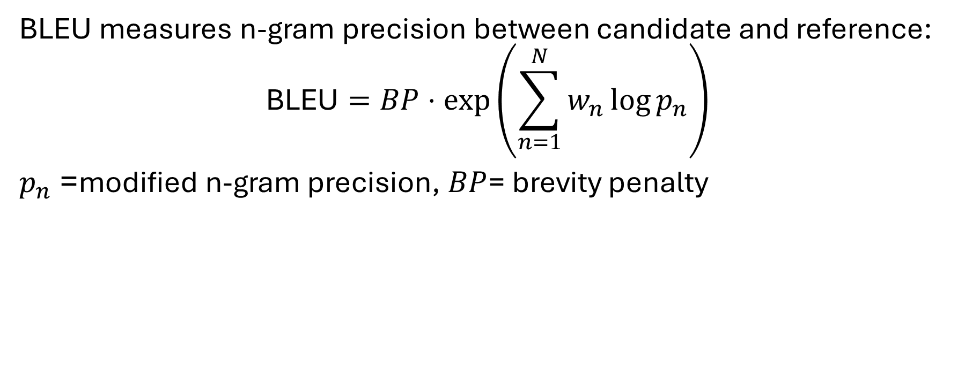
2.1 BLEU (Bilingual Evaluation Understudy)
BLEU measures n-gram precision between candidate and reference:
$$\text{BLEU}=BP⋅\exp\left(\sum_{n=1}^{N}{w_{n}}\log{p_{n}}\right)$$
$p_{n}$= modified n-gram precision, $BP$= brevity penalty
Simple and widely used in Machinne Translation
Precision only (ignores recall), penalizes paraphrasing, poor correlation with human judgment

Slide 48
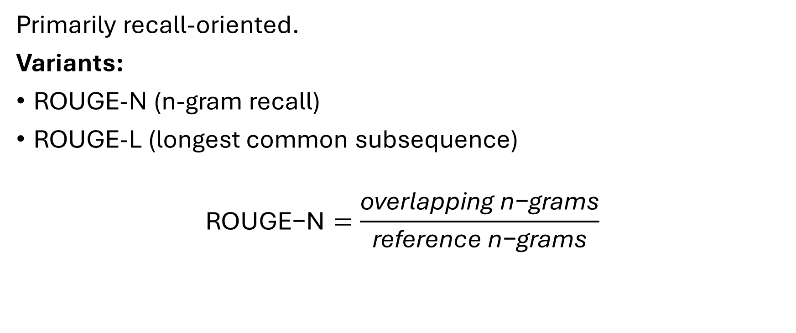
2.2 ROUGE
Primarily recall-oriented.
Variants:
ROUGE-N (n-gram recall)
ROUGE-L (longest common subsequence)
$$\text{ROUGE}\text{−}\text{N}=\frac{\text{overlapping} \text{n}\text{−}\text{grams}}{\text{reference} \text{n}\text{−}\text{grams}}$$
Works well for summarization, Measures content coverage,
Cannot detect semantic equivalence

Slide 49
2.3 METEOR
Metric for Evaluation of Translation with Explicit ORdering. Improve the shortcomings of the BLEU metric by correlating better with human judgments of quality.
A score based on the alignment between a machine-generated sentence (the "candidate") and one or more human-created reference sentences, Combines Precision, Recall, Stemming and Synonym matching.
It penalizes translations where the matched words are not in a similar order in the candidate and reference sentences.

Slide 50
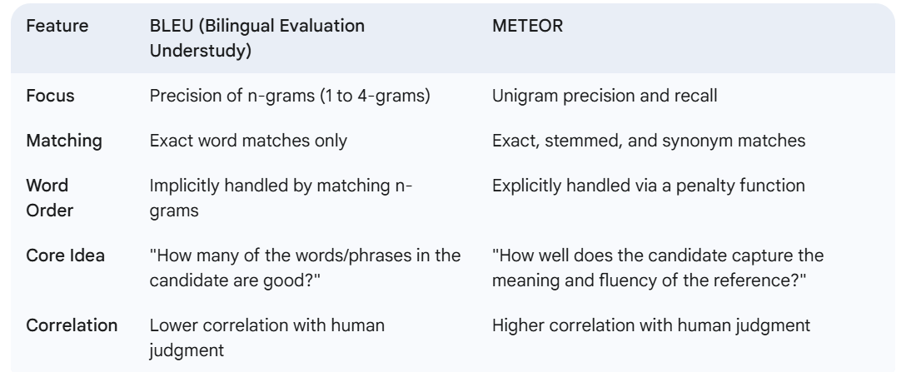
METEOR is a more sophisticated and semantically-aware metric than BLEU, making it a powerful tool for evaluating the nuanced text generated by modern LLMs.

Slide 51
3.1 BERTScore
Computes contextual embeddings (e.g., BERT) for candidate and reference tokens and measure cosine similarity.
For each token find the most similar token in the reference. Aggregate precision and recall.
Captures semantic similarity
Robust to paraphrasing
Computationally expensive
Depends on embedding model

Slide 52
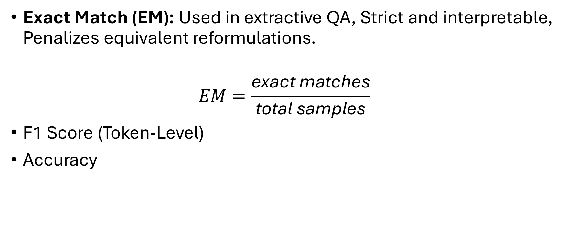
4. Task-Specific Metrics
Exact Match (EM): Used in extractive QA, Strict and interpretable, Penalizes equivalent reformulations.
$$EM=\frac{\text{exact} \text{matches}}{\text{total} \text{samples}}$$
F1 Score (Token-Level)
Accuracy

Slide 53
5. Human Evaluation
Fluency
Coherence
Relevance
Factuality
Helpfulness
Harmlessness
Scales: Pairwise ranking, Best-of-N comparison
Expensive
Noisy
Inter-annotator variance

Slide 54
LLM-as-a-Judge
Using a stronger model to evaluate outputs.
Methods:
Pairwise preference
Rubric-based scoring
Self-consistency voting
Strengths
Scalable
Often correlates with human judgments
Weaknesses
Bias toward similar models
Prompt sensitivity
Circularity risk

Slide 55

Preference-Based Evaluation (Alignment Metrics)
Used in RLHF and DPO training.
Win Rate
$$\text{Win} \text{Rate}=\frac{\text{wins}}{\text{wins}\text{ + }\text{losses}}$$
Used in pairwise comparison settings.

